Slide 1

Processing text search results
Retrieving information from PharmaPendium
Marnix Wieffer
Senior marketing manager drug safety
Notes:
Hello everybody and welcome to this tutorial video, where I will show you how you can further process the results from your quick and advanced text searches

Slide 2
Learning objective
Results page
Sorting
Filtering
Use the “Show drugs in” feature
Save and export
Search in Embase
Document view page
Search within Documents and approval packages
Download documents and copy content
At the end of this video you should be able to refine and process text search result and documents
This should enable your to zoom into critical information quickly and further process the information in the format relevant for you
Notes:
During this training session we will first take a look at how to work with the results page and discuss how we can….
Next we will take a look at the document view page and explore how we can ….
At the end of this video you should be able to refine and process text search result and documents
This should enable your to zoom into critical information quickly and further process the information in the format relevant for you

Slide 3
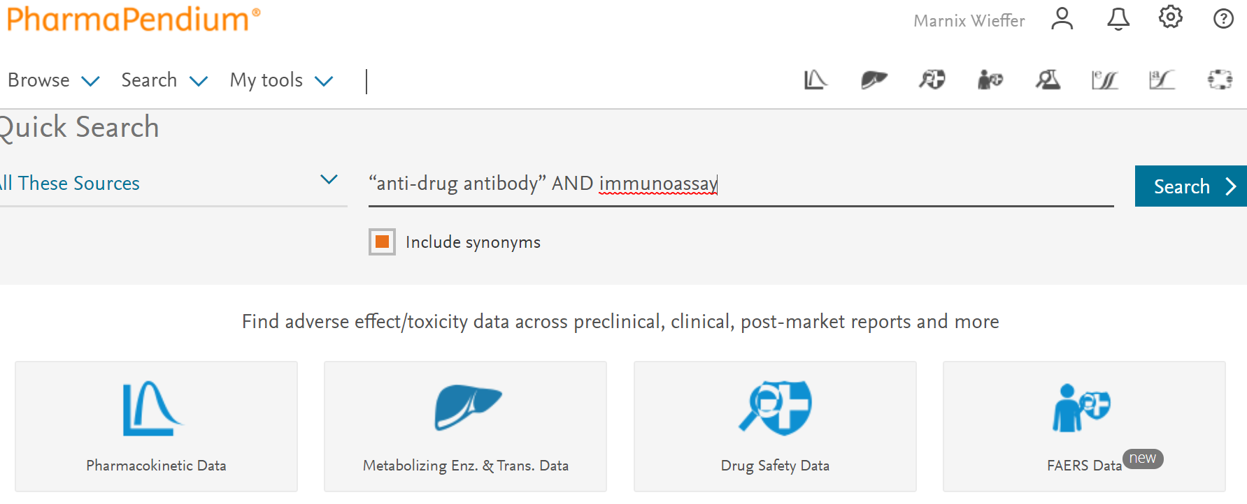
A quick search for immunoassays for anti-drug antibodies
Recommended: Quick search tutorial video
https://service.elsevier.com/app/answers/detail/a_id/5198/supporthub/pharmapendium/kw/Quick+search/
Notes:
Let’s assume that we would like know what immunoassay we would need to use to detect anti-drug antibodies. It would be immensely helpful if we can take a look at what immunoassays were used for drugs that are currently on the market and what feedback was provided on those assays by EMA and FDA reviewers.
For this example, let’s repeat the search we did for the quick search tutorial video
“anti-drug antibody” AND immunoassay
“Anti-drug antibody” AND immunoassay

Slide 4
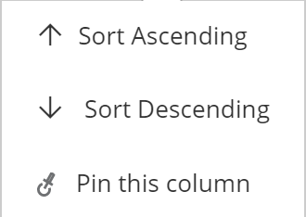
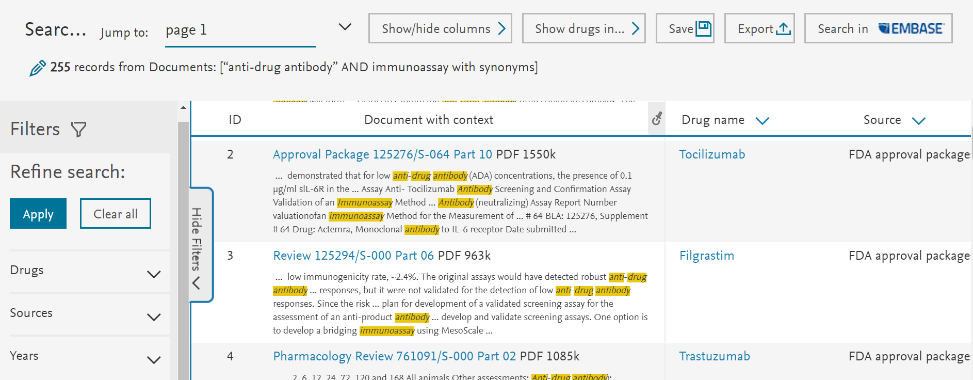
255 results that we can sort and organize
Notes:
We get 255 results, for each record we see the context and highlighted in yellow the search terms we were interested in. Next, there is the Drug name, source and the year. So for the second line, the terms “Anti-drug antibody” AND “immunoassay” were found in the approval package for Tocilizumab, that was published in 2013.
FDA advisory committee meeting are generally not linked to a specific drug, therefore there is no drug name in the first result.
255 data lines might be too much to analyze and we could use some help zooming in to the data most relevant for us. First we can sort the data either Ascending or descending. Depending on the content this is either alphabetically or numerically. We can also pin a column to left, for example the column year . Especially if we start working with the data modules where we can have up to 30 columns, this is a convenient option to group the data most important to you together.

Slide 5
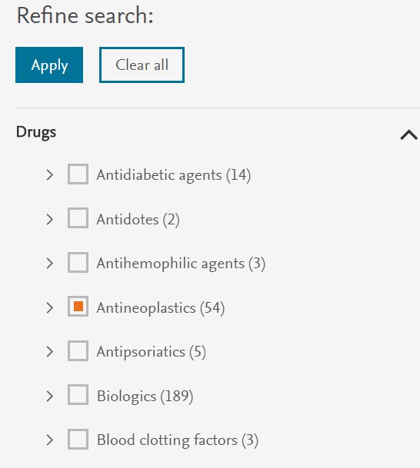
255 results that we can filter on year, source and drug/ drug class
Notes:
Further we can filter our results
->we can open and close the filter section by clicking on show and hide filters.
->further, we can size the filter section, to optimize the view
Within the text search results page we have 3 filters available, year, source and drug/drug class
With the year filter we can filter our results based on publication year of the document
With the source filter we can filter on the various document sources. We can also drill drown by clicking on “arrow” symbol.
The filters in PharmaPendium will let you know the number of filters in each category, providing useful insights into the relative distribution. We can see that in FDA document, that anti-drug antibody in combination with Immunoassays is most frequently mentioned in the Clinical Pharmacology and Biopharmaceutics Review section./ This helping us to guide our search to find the right information.
Last, we can filter based on drug class and name using our the PharmaPendium drug filter that uses the PharmaPendium drug taxonomy. We can see that 54 results are from approval documents on drug classified as antineoplastic. Let’s assume that our drug under development is an antineoplastic and zoom into those documents.
how many of. Let’s for example say that we are specifically interested in the

Slide 6
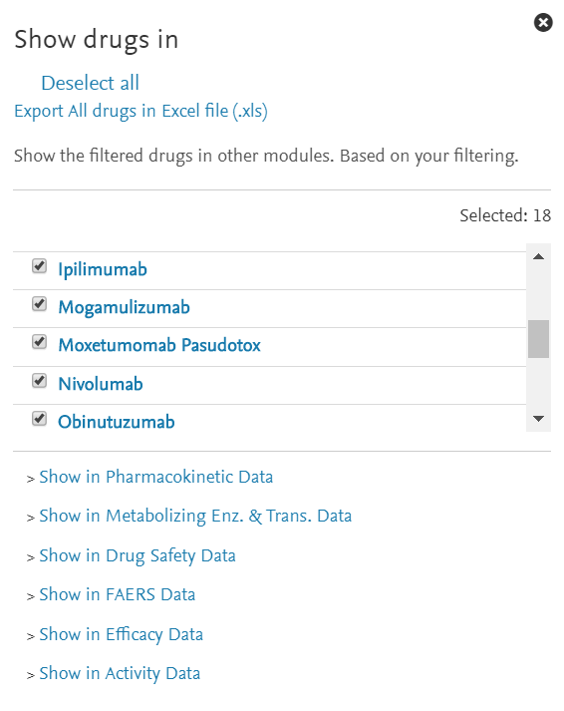
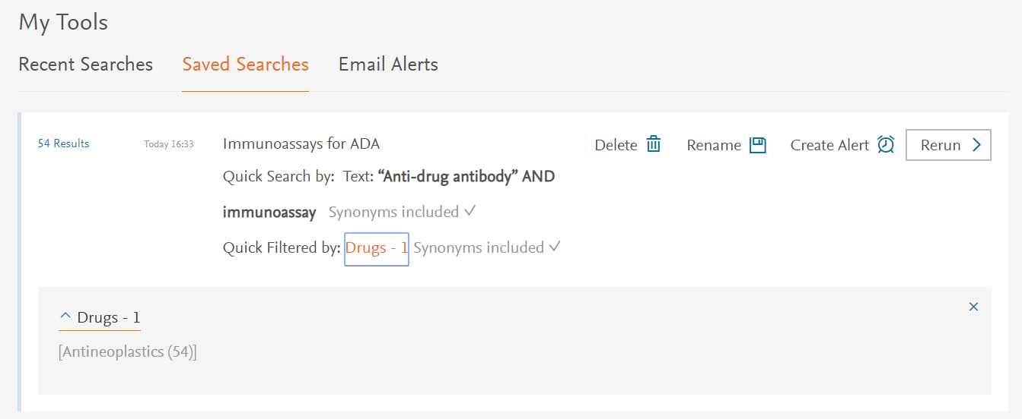
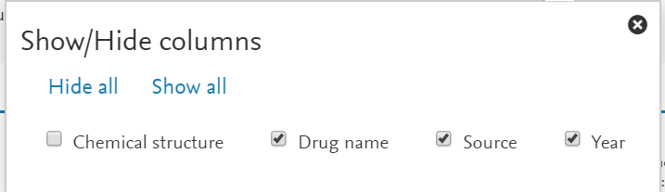
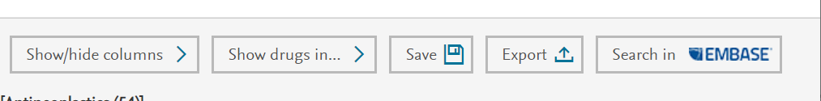
We can further process our results
Look at available data on listed drugs
Save search to account
Add columns to our results page view
Notes:
This filter action has reduced the number of records to 54. Now let’s take a look the features in right upper corner that will help us to further explore and process the data
Show/hide columns allow us to remove or add columns to our results page view. For text search results there are only 4 columns, however in follow-up videos when we are working with extracted data, there are many more columns. By hiding non relevant columns, you focus on the data most relevant for you
“Show drugs in” will tell us from what drug approval packages our search results were retrieved information. These drugs correspond to drugs mentioned in the “drug names column”. In this example there are 18 drugs. We can easily export this list of drugs into and Excel. The drugs in the excel sheet are hyperlinked, and will take you to the PharmaPendium drug overview page. We will talk more about the “drug overview page” in the tutorial on browsing PharmaPendium.
The “show drug in feature” will also allow you look at all the data available in any of the various modules available. In this example, if I would like to take a look at all the PK data on these 18 drugs, I simply click on “show in Pharmacokinetic data” ,that will take me to the PK data view
We can save the search to your account. To use this feature, you need to be logged in to PharmaPendium. You can access and rerun your saved searched from “my tools” and “saved searches”
Tagraxofusp-erzs is a fusion protein consisting of interleukin 3 fused to diphtheria toxin.
Wikipedia
interleukin 3 fused to diphtheria toxin
how many of. Let’s for example say that we are specifically interested in the

Slide 7
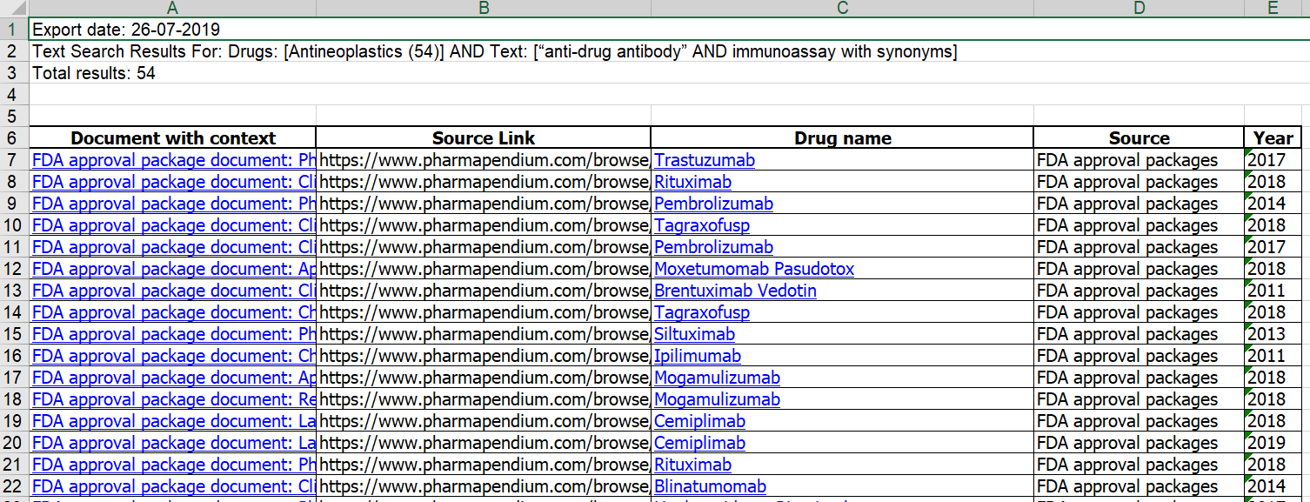
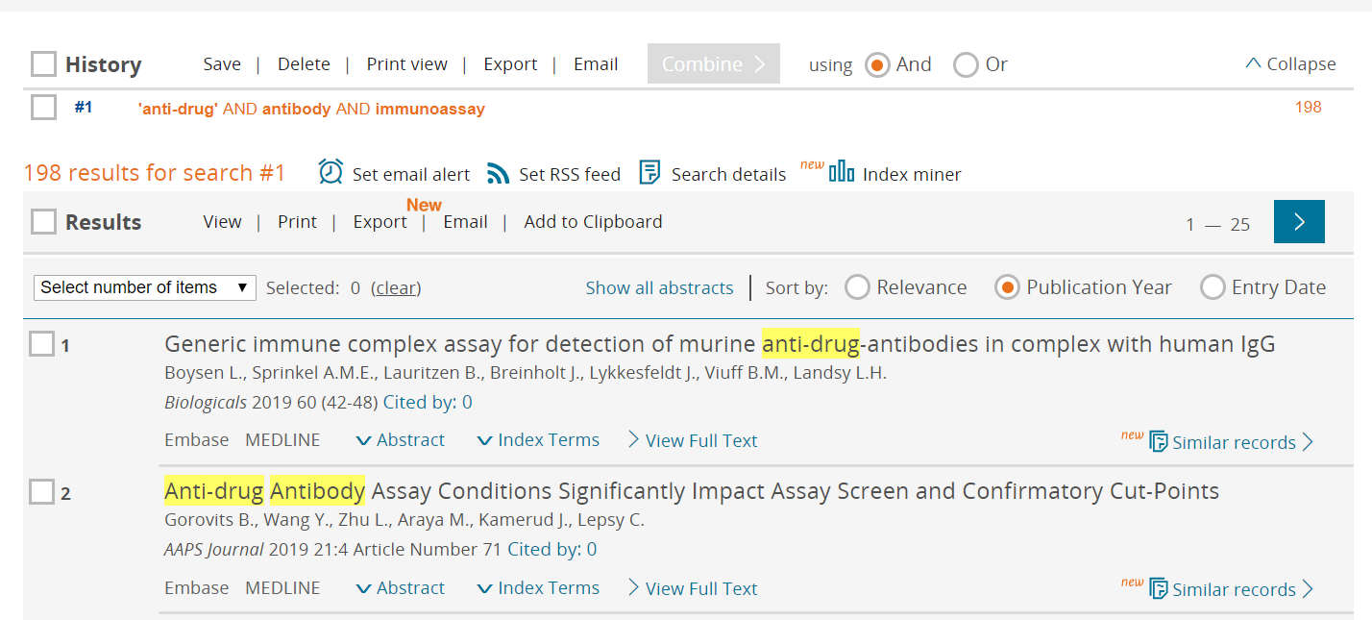
We can further process our results
Excel sheet, data linking back to PharmaPendium
Take your search to Embase to get a comprehensive overview
Notes:
Next we can export our results in various formats. The Excel export contains hyperlinks to the original documents as well as to the PharmaPendium drug overview page.
Last we can export our text search to Embase, Elsevier’s industry standard biomedical literature database, thereby further broadening our search
https://www.elsevier.com/solutions/pharmapendium-clinical-data/drug-safety

Slide 8
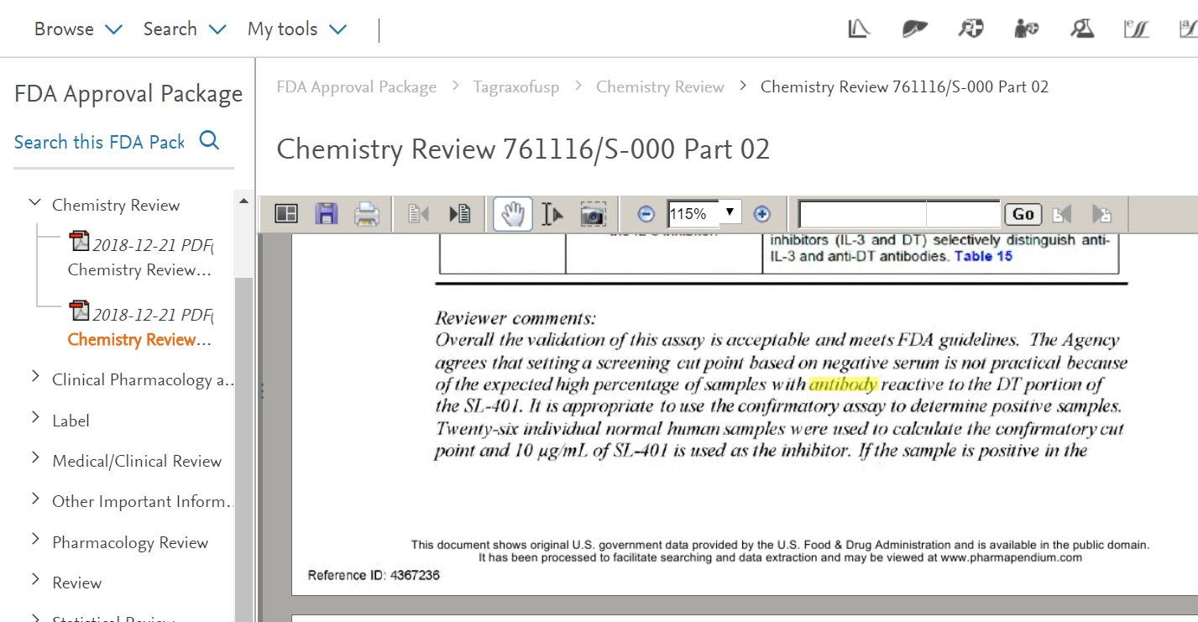
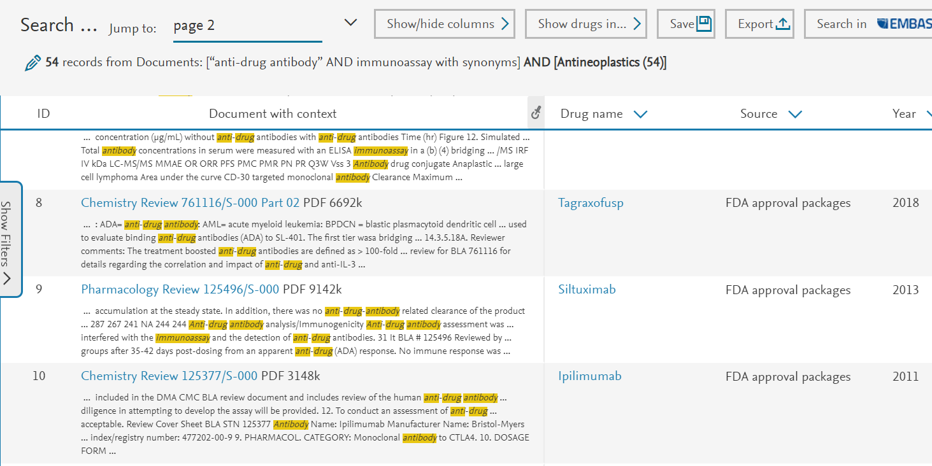
Access to the full text searchablel approval package
Notes:
Let’s dive in and explore what we can do with the documents in PharmaPendium and click on the Clinical Pharmacology and Biopharmaceutics Review on Tagrax-o-fusp
First, on the left hand side we can see the full approval package and the opportunity to search in the full text of the package. On the right side we see the full text clinical Pharmacology review.

Slide 9
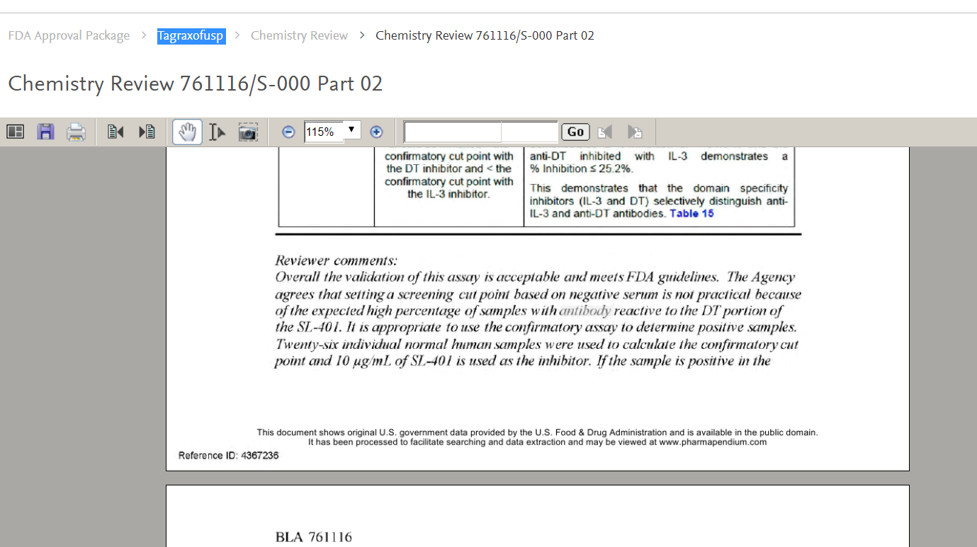
Zooming into the relevant information
Download
Search within document text
Print
Copy text
Zoom in/out
Open preview
Take a snapshot
Look for previous/next search term
Look for previous/next search term
Notes:
On the topside of the document we have a couple of search an processing options
1) First we have a preview option, providing a visual page overview of the document for easy navigation
2) Next, we can download the document as a PDF or print it
3) As you are no doubt aware, many of the FDA documents are scanned microfiche files, therefore they are not text searchable and content is very poorly discoverable. For PharmaPendium we made all the document text searchable to unlock the information inside. Highlighted in yellow and grew we can find the keywords we looked for. Using the arrow buttons we can easily toggle between the recovered keywords.
In this example we can read that the reviewer comments that “Overall the validation of this assay is acceptable and meets FDA guidelines”. Therefore, the assay is described a bit further up in the document is an excellent starting point for setting up your assays.
We can further search the document in full text for information of interest using the search bar. For example, if you would like to quickly scan the document for further reviewer comments, we can type “reviewer” and click “go”. We can now toggle between the terms using the arrow button on the right hand side
Information of interest can easily be copied using the text selection tool. Figures of interest can be copied using the image capture tool> Thereby we can easily make report in for example word

Slide 10
Assay used to detect ADAs for Tagraxofusp is acceptable for the FDA
Notes:
With this example I’ve shown you how you can use texts searching option to gain insights into critical reviewer. We explored ho we can filter and process a list of results and how we can work with documents.

Slide 11
Notes:
With this video provide sufficient information to enable you to refine and process text search result and documents, allowing you to zoom into critical information quickly and further process the information in the format relevant for you.
I hope you found this video useful, thank you for you attention and good bye

